Slide 1
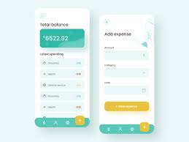
EXPENSE CALCULATOR
By,
MOHAMED HARSHAD M-RA2211003010152
ADAM SIDDIQ AYAPALLI-RA2211003010197
MOHAMMED HANNAD MK-RA2211003010198

Slide 2
Agenda
Expense Recording:
Users can input expenses with a date, description, and amount.
Recorded expenses are stored in a list.
Expense Management:
Users can edit and delete expenses.
The application updates the expense list accordingly.
Report Generation:
The app can generate yearly and monthly expense reports.
Reports display total expenses for each period.
User Interface:
Built using Tkinter, with input fields, buttons, a list of expenses, and a scrollbar.
Labels and message boxes provide feedback to the user.
Main Application Window:
The primary application window titled "Expense Tracker."

Slide 3
Abstract
This Python application is designed for expense tracking and management. Users can input expenses with details such as date, description, and amount. Recorded expenses are stored in a list and can be edited or deleted as needed.
The application offers report generation capabilities, providing yearly and monthly expense reports, which display the total expenses for each period. The user-friendly graphical interface, created using Tkinter, includes input fields, buttons, a list of expenses with a scrollbar, and informative labels.
The main application window is titled "Expense Tracker." This application simplifies expense management and analysis for users..

Slide 4
Modules Present
tkinter: This module is used for creating the graphical user interface (GUI) of the application, allowing for the creation of windows, buttons, labels, entry fields, and listboxes.
calendar: The calendar module is used to retrieve month names for the monthly expense report, making it easier to display report information.
datetime: Although not explicitly imported in the code, it's likely used indirectly for date handling and calculations in the application, which is a standard library for date and time operations.
Listbox, Entry, Label, Button, Scrollbar: These are components and widgets provided by tkinter to create the various elements of the user interface, such as text entry fields, buttons, labels, and listboxes.

Slide 5
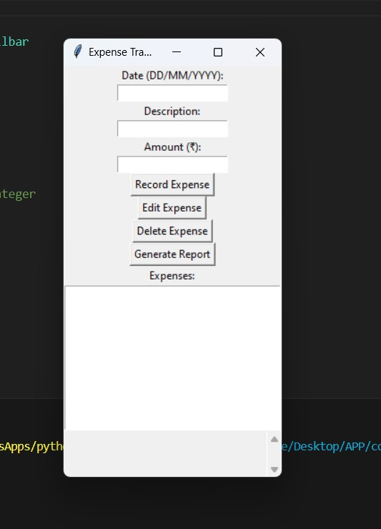
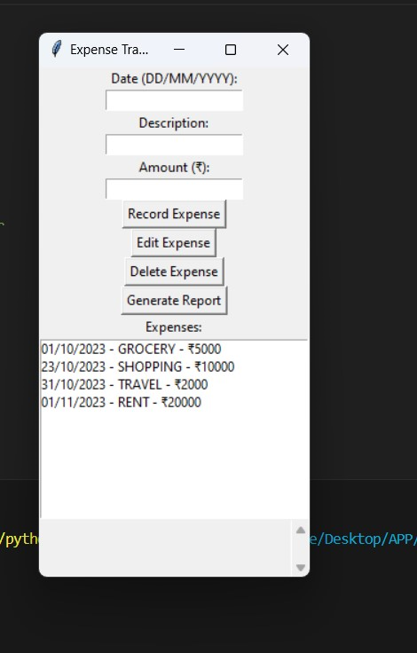
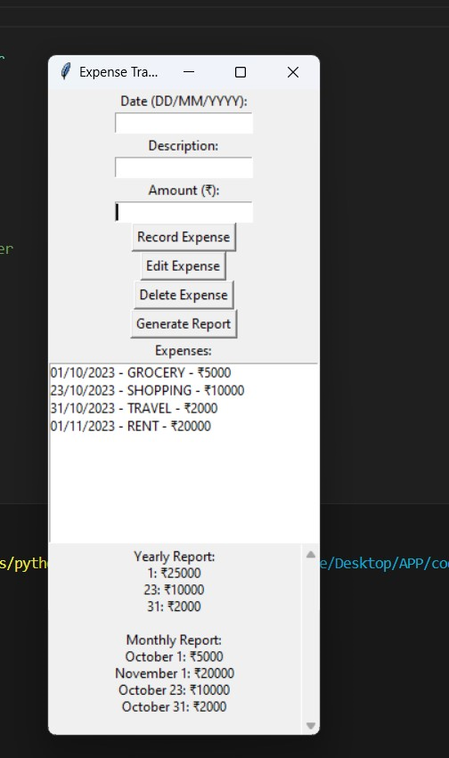
Code & Output
CODE SOURCE: EXPENSE CALCULATOR LINK
OUTPUT:

Slide 6
Uses
Expense Management: Users can track and manage their expenses, aiding budgeting and financial planning.
Business Finances: Small businesses and freelancers can use it for expense tracking and tax preparation.
Receipt Organization: It simplifies the storage and retrieval of receipts.
Financial Analysis: The app provides insights into spending patterns for informed financial decisions.
Household Budgeting: Families can efficiently manage shared expenses.

Slide 7
Conclusion
In conclusion, the provided Python expense tracking application offers a user-friendly solution for managing expenses in various personal and professional scenarios. It enables efficient expense recording, editing, and deletion while also providing valuable insights through generated reports. Whether for personal finance management, business expense tracking, or educational purposes, this application supports responsible financial practices and budgeting, ultimately contributing to better financial decision-making and control.
THANK YOU!

